Slide 1

ROYAL HOmes KING COUNTY Housing LINEAR REGRESSION ANALYSIS By Natalya Doris

Slide 2

Business Problem
We seek to answer the following questions:
What types of homes should Royal Homes sell to make the most profit?
What features lend towards higher sale prices?

Slide 3

THE Data
Feature | Description | Type
price | sale price (USD) | numerical
sqft_living | square footage of living space | numerical
zipcode | ZIP code used by the USPS | categorical
waterfront | whether the house is on the waterfront | categorical
view | quality of the view from house | categorical
condition | how good the overall condition of the house is | categorical

Slide 4
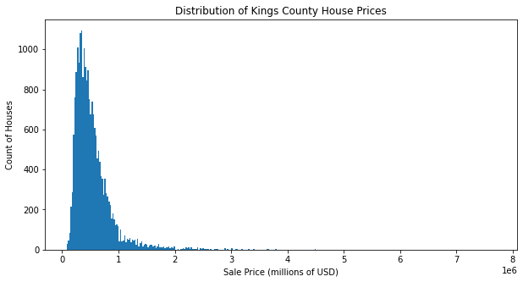

Slide 5
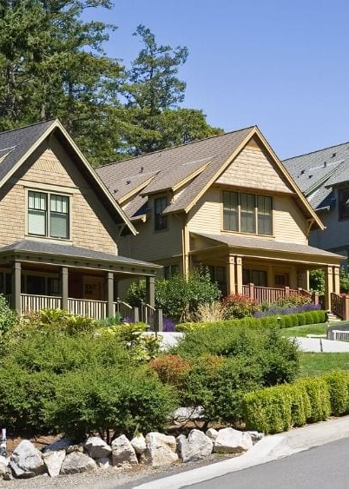
The Model
Features:
sq. ft. of living space
zip code
waterfront status
view
condition
Notes:
Image source: https://www.newhomesource.com/learn/how-to-choose-the-right-neighborhood/

Slide 6
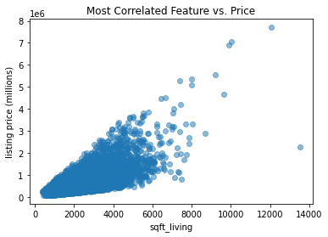
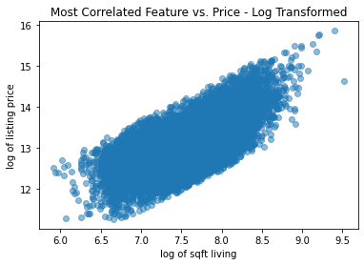
Model Selection

Slide 7
Model Results
Probability that coefficients are 0 is less than 5%
85% of variability in price explained by the model
R²: 0.845
P-values < 0.05
Skew: 0.05
Coefficient – sq. ft. living (log): 0.68
Coefficient – zip 98039 : 1.50
Meets model assumption (normality)
Suggestive of strong positive relationship between price and sq. ft. living; zip code 98039

Slide 8
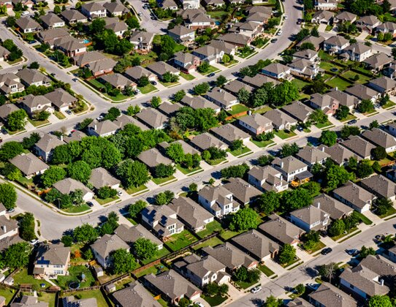
Recommendations
Sell homes in the following zip codes: 98039, 98004, 98112, 98102, 98109
Focus on homes with 2500 sq. ft. living or higher
Target waterfront properties and homes with good or excellent views
Avoid houses in fair or poor condition
Notes:
Image source: https://money.usnews.com/loans/mortgages/articles/when-house-hunting-how-to-assess-a-neighborhood

Slide 9
NEXT STEPS
Do a deep dive on top zip codes – what attributes do these houses most commonly feature?
Find data that breaks down ‘view’ into more specific categories – water view vs city view vs greenery, for example
Gather data on sales in more recent years – are there any attributes that are more impactful on sale price now?

Slide 10
THANK YOU
If any additional questions, feel free to reach me at:
ntdoris@gmail.com
(305) 395-0727

